Slide 1
Toxic Comment Classification
Group 14:
Yash Jain, 170050055
Aditya Sharma, 170050043
Debabrata Mandal, 170050073

Slide 2
Introduction and Motivation
Tech Companies like Facebook, Instagram, etc are all facing problems and issues related to online abuse, harassment, negative behaviour due because of toxic comments that people indulge in.
But the amount of comments and posts generated each day, it is impossible to manually classify the comments.
This poses a need for an automated classification which could handle the heavy traffic of comments and prevent negative impact of toxic comments.

Slide 3
Problem Statement
Build a deep learning model that’s capable of detecting different types of of toxicity like threats, obscenity, insults, and identity-based hates
Dataset
Kaggle’s Toxic Comment Classification: Comments from Wikipedia’s talk page edits.

Slide 4
Pre-processing the data
Dataset was skewed with Non-toxic comments occupying ~ 90% training data
Initial preprocessing techniques like resampling (over-sampling for minority classes & sub-sampling for majority class) seemed to worsen final output score
Non toxic comments dominated test set hence full training data for non-toxic comments were used
Due to limited training time on GPU decided upon not increasing dataset size by replication for minority class
Text cleaning - By removing extra whitespaces, punctuations & lowercase conversion & stemming etc. using the library ‘cleantext’

Slide 5
Language Model Used (1/3)
GPT-2
GPT2 is a large transformer based model. It has over 1.5 billion parameters and has been trained on 8 million webpages. Given the dataset, there is a lot of diversity that is included and hence a variety of domains are covered.

Slide 6
Language Model Used (2/3)
BERT
Bert falls under the category of “Masked Language Models” or MLMs. Instead of predicting the next word from the given context, Masked Language Models predict the identities of words that have been masked out of the input.
This makes Masked Language Models have an advantage of being bi-directional, over Language models like GPT2. Since they only predict a small subset of input, the learning per instance of sentence is reduced.

Slide 7
Language Model Used (3/3)
ELECTRA
This also falls under the category of Masked Language Models. However, Electra uses a different pre-training technique of Replaced Token Detection or RTDs. The input is corrupted by replacing some tokens from inputs instead of masking them. This replacement comes from another Neural Network called Generator. Since the classification task is applied to every input token, this learns more than BERT on an input instance.

Slide 8
Classification Technique: Binary Relevance
We chose Binary Relevance as the technique for our classification. The reasons are the following:
It allows us to predict membership to each of the classes separately. This allows us to even correctly predict the comments which lie in more than 1 category.
It has the advantage of fewer classifiers and parameters than techniques like Power Set labellings which may have (2^|C|) classifiers.
However it has a disadvantage. This will not be able to learn correlation in classes, if it exists.

Slide 9
Approaches Made - Neural Net Architectures
Language Model(electra/gpt2/bert) + Dense Layer + Sigmoid output
Language Model(electra/gpt2/bert) + Dense Layer + Dropout Layer + Dense Layer + Sigmoid output
Language Model(electra/gpt2/bert) + Bi-LSTM Layer + 1D MaxPool Layer + Dense Layer + Dropout Layer + Dense Layer + Sigmoid output

Slide 10
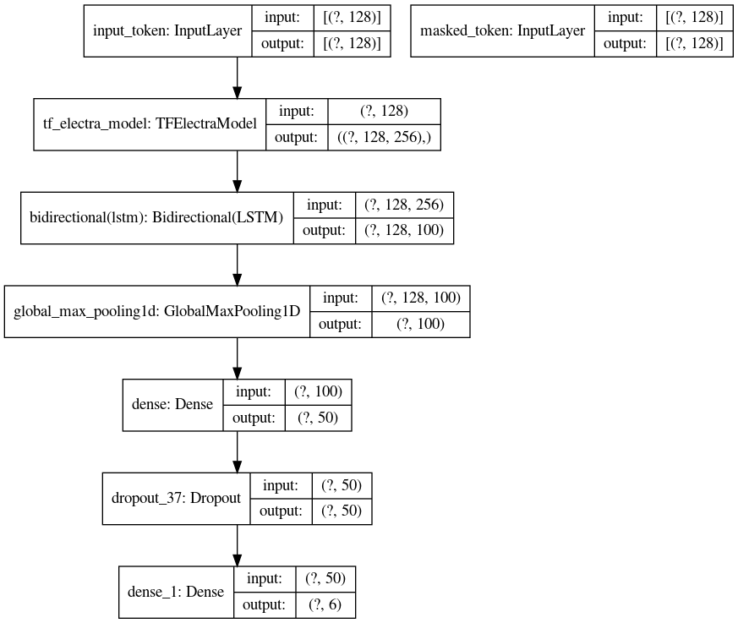
Architecture
Transformer language models used:
GPT2
ELECTRA
BERT

Slide 11
Evaluation
Configuration | Overall Accuracy
ELECTRA | 94.6
GPT-2 | 95.7
BERT | 97.5
Baseline (LSTM) | 96.6

Slide 12
Reason for good performance of LSTM
Since, the dataset is quite large, the native embeddings learned by the baseline model tuned better than the large transformer models. The embeddings that we trained are more dataset specific, i.e., comment text. Had the dataset size is reduced the transformer models will perform better.

Slide 13
Model trained only on 10% of the data
Configuration | Overall Accuracy
LSTM | 88.537
BERT | 94.602

Slide 14
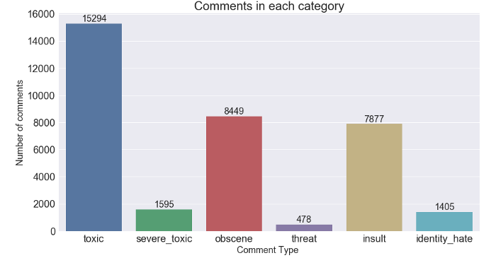
Error Analysis
Threat Class
Since the class threat has least number of examples, the model is not able to fully grasp the features of the Threat class. Therefore, we are not getting satisfactory results for this class.
Example: Fine, I will destroy you. This should be classified in Threat but it is not.

Slide 15
Error Analysis(2)
2. Long Comments and Padding
Sentence | Insult Score
It's a ******* disgrace. | 0.86
Oh! you are so nice. It's a ******* disgrace. Oh! you are so nice. | 0.84
Oh! you are so nice. It's a ******* disgrace. Oh! you are so nice. Oh! you are so nice. Oh! you are so nice. Oh! you are so nice. | 0.81
Thus you can easily fool the predictor by padding the toxic comment, or using sarcasm.
Solution given on future work slides.

Slide 16
Error Analysis(3)
2. Sarcasm hiding true intentions
Sentence | Insult Score
It's a ****** disgrace. | 0.86
Oh! you are so nice but then you seem no different. It's a ****** disgrace. | 0.78
Thus you can easily fool the predictor by padding the toxic comment, or using sarcasm.
Solution given on future work slides.

Slide 17
Problems and difficulties faced:
Understanding language models and how they work. After that we integrated it in our code.
The dataset was skewed. Hence we faced difficulties bringing out correct classification of positive classes.
Training the data required GPU. Therefore we used 35 hr GPU quota weekly from all of our accounts to train and get desired results.
Understanding why the initial neural net architectures underperformed.

Slide 18
Future Work and Scope of Improvement
We hope to involve more language models. Since we have the base code and everything ready, we can easily include models like RoBERTa, etc.
By performing advanced dataset preprocessing techniques like minority class oversampling (replication) or pseudo labelling, we could improve overall accuracy.
To overcome the padding problem(and to some extent sarcasm), we can classify each sentence in the comment rather than classifying the entire comment.

